Slide 1


SparseWeaver: Converting Sparse Operations as Dense Operations on GPUs for Graph Workloads
Shinnung Jeong†, Liam Paul Cooper‡, Ju Min Lee†, Heelim Choi†, Nicholas Parnenzini‡, Chihyo Ahn‡, Yongwoo Lee†, Hanjun Kim†, and Hyesoon Kim‡
Yonsei University, South Korea†, Georgia Institute of Technology, USA‡
2025 IEEE International Symposium on High-Performance Computer Architecture
Notes:
Thanks for kind introduction.
Good morning, My name is shinnung Jeong.
Today I will introduce my work SparseWeaver. Converting Sparse Operations as Dense Operations on GPUs for Graph Workloads
This work is collaborative work with Yonsei university and Georgia tech.

Slide 2


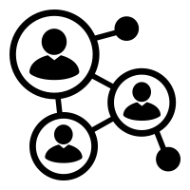
Graphs are Important Data Structures to Abstract and Analyze the Real-World Data
Web Search
Social Network
Path Finding
Biology
Characteristics of
Real-World Graph
Irregularity
Sparsity
Skewness
Notes:
Graphs are one of the most important data structures for abstracting and analyzing real-world data. A graph can represent various real-world relationships, such as web page links and social networks.
So, Real-world graphs exhibit notable characteristics, particularly irregularity, including sparsity and skewness. In here, skewness refers to a small number of vertices being connected to a large number of edges, similar to influencers on Twitter.

Slide 3
What is Graph processing?
Apply
V0
Gather
Gather information on neighbor edges
Apply computation to vertices using gathered data
Perform the same algorithms to each vertex and edge -> Easily parallelizable!
E0
E3
V1
V4
E1
E2
E4
E5
V2
V3
E6
Example Graph
Notes:
By analyzing graphs, user can extract useful data from these real-world relationships.
How the analyze processed?
The graph processing can consist of two parts,
First is gather operation, updating vertex data by gathering neighbor edge data
For example, update vertex 0 by gathering four neighbor edges E0, E1, E2, and E3
and Second is apply operation on gathered data after finishing gathering
Graph processing typically applies the same gather and apply operation to each vertex or to each edge, making it highly parallelizable.

Slide 4
GPU is a Promising Platform for Dense Operations
Apply
Size of Real-world graphs are growing
Graph processing is highly parallelizable
GPU is a powerful SIMD processor
V0
E0
E3
V1
V4
E1
E2
Apply Operation (Dense Operation)
SIMD friendly work distribution
E4
E5
V2
V3
Thread 0 | Thread 1 | Thread 2 | Thread 3
Apply(V0) | Apply(V1) | Apply(V2) | Apply(V3)
Apply(V4)
E6
Time
Example Graph
Notes:
As real-world graphs grow larger, with millions of vertices and billions of edges.
GPUs, known for their effectiveness in single instruction multiple data applications, GPU looks fit for accelerate graph processing using their massive parallel resources.
As shown in the table on the right bottom, the apply operation can be accelerated by mapping each vertex to each thread on the GPU.

Slide 5
However, Graph Processing on GPU is Challenging Because Gather Operation is Sparse Operation
Sparse Workload Information
V0 | V1 | V2 | V3
4 edges | 1 edge | 0 edge | 1 edge
V0
Gather
parallel_for(v : graph){
for(e:neighbor_edges(v) ){
Gather(v, n)}
}
E0
E3
V1
V4
Naïve Scheduling
E1
E2
E4
E5
Sparse Operation
Workload imbalance problem
V2
V3
E6
Thread 0 | Thread 1 | Thread 2 | Thread 3
Apply V0 | Apply V1 | Apply V2 | Apply V3
Apply V4
Thread 0 | Thread 1 | Thread 2 | Thread 3
Gather(E0) | Gather(E4) |  | Gather(E5)
Gather(E1)
Gather(E2)
Gather(E3)
Time
Example Graph
Notes:
However, graph processing on GPU is still challenging because the gather operation is sparse operation.
Since graphs is sparse and skewed,
When performing gathering operations, this characteristics can cause irregular distribution, which induces workload imbalance and reduces resource utilization.
For example, the green, sparse workload information table shows that vertices has 4, 1, 0 , and 1 neighboring edges.
The naïve scheduling map each vertex and its neighbor edges to each thread as shown in the code.
Finally, As shown in right bottom table, since Vertex 0 has the largest neighbor edges, it takes 4 locksteps to finish the gather operation,
while the other thread waits for a maximum of 4 locksteps as idle status

Slide 6
Converting Sparse Gather Operation as Dense Operation is Important!
Sparse Workload Information
V0 | V1 | V2 | V3
4 edges | 1 edge | 0 edge | 1 edge
Naïve Scheduling
Good Scheduling
Sparse Operation
Imbalanced workload distribution
Dense Operation
SIMD friendly work distribution
Thread 0 | Thread 1 | Thread 2 | Thread 3
Apply V0 | Apply V1 | Apply V2 | Apply V3
Apply V4
Thread 0 | Thread 1 | Thread 2 | Thread 3
Gather(E0) | Gather(E1) | Gather(E2) | Gather(E3)
Gather(E4) | Gather(E5) | Gather(E6)
Thread 0 | Thread 1 | Thread 2 | Thread 3
Gather(E0) | Gather(E4) |  | Gather(E5)
Gather(E1)
Gather(E2)
Gather(E3)
Time
Reduced time
Notes:
However, if we use proper scheduling such as right table shown.
GPU can perform Graph workload as Dense operation
The scheduling enable simd friendly workload distribution and better resource utilization.
(3:22)

Slide 7
Existing SW Scheduling methods Address the Problem, But with Overhead
Existing SW Scheduling Attempts to Solve Workload Imbalance
Often better than naïve scheduling
Software Solutions Introduce Overhead
Additional computations, synchronizations, atomics, or memory operations with binary search, etc.
Each thread independently calculates its allocated work ID (edge ID), increasing overhead
Notes:
Since workload balancing is important, existing SW scheduling methods attempt to address the problem but introduce some overhead.
They are definitely better than naïve scheduling, but they require additional computations, synchronization, atomic operations, and memory access, including binary search.
For example, in BFS, only an atomicMin operation is needed for the gather operation. In comparison, SW scheduling introduces significantly more overhead.
This overhead occurs because each thread independently calculates its allocated work ID, which in this case refers to the edge ID for the gather operation.

Slide 8
Can SW Scheduling be Considered a Fundamental Solution?
Mismatch arises between sparse operations and dense hardware
Solving this mismatch in software side induces overhead
Can this problem be addressed with a hardware solution?
How can we efficiently solve this with minimal hardware overhead?
How can we ensure efficiency while maintaining the composability of other parts of the graph algorithm?
Notes:
So, this raises the question: Can SW scheduling be considered a fundamental solution?
Going back to the root of the problem, the mismatch arises between sparse operations and dense hardware.
Addressing this mismatch in software inevitably introduces overhead.
Is it truly impossible to solve this problem with a hardware solution? If not, how can we suggest an efficient solution with simple hardware while maintaining composability?
Here, composability means ensuring that the solution does not interfere with other components of the graph processing framework or algorithm.
(5:00)

Slide 9
Observation 1: Two Stages of SW Scheduling Methods
Registration Stage: All threads in the core investigate neighbor information
Distribution Stage: All threads in the core generate work edge IDs
Filter(VID)
Get_Next_EdgeID
Get Edge
Info
Gather
Get_Neighbor(VID)
Update_Shared_Data
Prepare_Shared_data(VID)
Registration stage
Generate Workload Information
Distribution stage
Work Generation
Notes:
So, Here is our two key observations.
The first observation is that we can abstract scheduling methods into two stages: registration and distribution.
In the registration stage, all threads in the core analyze the neighbor information they need to process. They apply filtering, load neighbor information data, and prepare shared information for next stage.
Once registration is complete, they move on to the distribution stage.
threads recursively generate edge IDs, for accessing edge information and performing the gather operation.

Slide 10
Observation 2: SW Scheduling, Fundamentally Decoding
SW Scheduling’s ultimate goal is decoding
Each thread independently generates its work ID(Edge ID) using shared information
Sparse Workload Information
Filter(VID)
Get_Next_EdgeID
Get_Neighbor(VID)
*Fundamental Steps
Update_Shared_Data
Naïve Scheduling
Prepare_Shared_data(VID)
Sparse Operation
Workload imbalance problem
Registration stage
Generate Workload Information
Distribution stage
Work Generation
Notes:
So, what exactly are they doing in these two stages?
Their ultimate goal is similar to decoding—transforming sparse operations into dense ones by decoding workload information.
For that, each thread independently generates its own work id same as edge id.
In the figure blow, the orange boxes represent the fundamental process of decoding!

Slide 11
Solution: Offloading Fundamental Steps to HW (Weaver)
Add a lightweight hardware execution unit in the GPU pipeline
Optimize the Decode Process
Centralize decoding hardware to reduce per-thread overhead
Each thread minimizes overhead with centralized scheduling
Filter(VID)
Get_Next_EdgeID
Weaver
Mapping Generation Hardware
Get_Neighbor(VID)
Update_Shared_Data
Prepare_Shared_data(VID)
Offload
Registration stage
Generate Workload Information
Distribution stage
Work Generation
Notes:
So, our solution is: What if we add a lightweight hardware unit to offload the fundamental part of scheduling?
By introducing a lightweight, dedicated execution unit, the hardware can optimize the decoding process for greater efficiency.
With centralized decoding hardware, each thread can avoid overhead and achieve more efficient scheduling.

Slide 12
Solution: Offloading Fundamental Steps to HW (Weaver)
Maintaining Composability
Supports existing graph algorithm
Offloading starts filtering and obtaining neighbor information
Ensures seamless integration with minimal code changes
Filter(VID)
Get_Next_EdgeID
Weaver
Mapping Generation Hardware
Get_Neighbor(VID)
Update_Shared_Data
Prepare_Shared_data(VID)
Offload
Registration stage
Generate Workload Information
Distribution stage
Work Generation
Notes:
This approach also helps maintain composability.
Since hardware offloading happens after filtering and obtaining neighbor information, it does not interfere with existing graph algorithm.
Most importantly, this method only requires input and output integration, ensuring seamless integration with minimal code changes.

Slide 13
Big Changes in System? Not at All! (System Overview)
Input
Graph UDF func
Storage Format & Interface
Gather(int src, int dest, int eid){
depth[dest] = step + 1}
Dfilter(int vid){return depth[dest] == step + 1}…
getNeighbor (vid, &start, &end){
start = loc[vid]; end = loc[vid + 1];}
getEdge (vid, eid, data, &src, &dest){
src = vid; dest = list[eid];}
Extend GPU ISA with only three new instructions for seamless code integration
Enhance the GPU pipeline with a new execution unit(Weaver)
sparseWeaver_gather_bfs(){ …
for(…){
Filter(vid)
Get_neighbor(&start, &end);
if(depth[src] == STEP)
WEAVER_REG(id,start,(end–start));//Input
}
sync()
for(…){
vid = WEAVER_DEC_ID(); // Output 1
…
eid = WEAVER_DEC_LOC(); // Output 2
src, dest, weight = Get_Next_EdgeID(vid, ptr)
…}}
Compiler
Compilation Flow
Frontend Output
Registration Stage
Schedule
Fetch
Decode
Issue
Execute
Commit
Front
-end
Built-in Library Linking
sparseWeaver_gather(){ …
for(…){
getNeighbor(&start, &end);
if(depth[src] == STEP)
WEAVER_REG(id, loc, deg);}
sync()
for(…){
id = WEAVER_DEC_ID(); …
loc = WEAVER_DEC_LOC();
src, dest, weight = getNextEdgeID(…)
if(depth[dest] != step + 1)
depth[dest] = step + 1 … }}
Warp Table
Writeback
ALU
Register File
FPU
Graph Kernel Generation
Warp Scheduler
ICache Stage
LSU
Commit Unit
Decode Stage
Back
-end
Thread Activate Code Insertion
Scoreboard
SFU
Distribution stage
Device Kernel Translation
Active Warps
Stalled Warps
Weaver
Visible Warps
IBuffer
ISA
WEAVER_REG, WEAVER_DEC_ID, WEAVER_DEC_LOC, WEAVER_SKIP
Barrier Table
Shared Mem.
Frontend compiler output
GPU Core
Notes:
The code on the left shows how the three ISA extensions are integrated into the existing code.
In the registration stage, the code runs after filtering and retrieving neighbor information.
The only modification needed is replacing the shared data preparation step with the new ISA.
In the distribution stage, the code proceeds by receiving the vertex ID (VID) and Edge id using two new ISA instructions for output.
Additionally, a few changes in the GPU cores are required.
In addition, the core side also only need some modification.
we modify the decode stage and introduce a new execution unit, which is highlighted in orange.

Slide 14
SparseWeaver Execution Flow
Time
⓵ Gather Workload Information
WEAVER_REG
(base VID, ptr, deg)
⓶ Return work IDs
VID = WEAVER_DEC_ID()
EID = WEAVER_DEC_LOC
Warp Execution Flow
Warp0 REG
Sync
Warp1 DEC
Neighbor Information Table
Weaver
Edge ID Table
SparseWeaver
Registration Stage
Distribution Stage
Notes:
So, The SparseWeaver execution follows this process:
In the registration stage, it gathers work information using ISA instructions and stores it in the neighbor information table.
After synchronization,
during the distribution stage, Weaver returns work IDs, such as VID and EID, using the edge ID table.
(7:8)

Slide 15
SparseWeaver Execution Flow
④ Receive VID after request
VID = WEAVER_DEC_ID()
⑥ Return EID after request
EID = WEAVER_DEC_LOC
① Store shared data indexed by warp ID
WEAVER_REG (base VID, ptr, deg)
Warp Execution Flow
Warp0 REG
Warp2 REG
Warp1 REG
Sync
Warp1 DEC
Warp0
DEC
Warp2
DEC
Neighbor Information Table
Weaver
Edge ID Table
SparseWeaver
Warp1
Reg data
Warp2
Reg data
⑤ Store EID
② Scan the buffer in entry ID order
⓷ Decode by Weaver
Out-Of-Order Registration &
Ordered Scan
Ordered Decode &
Dynamic Distribution
Notes:
Let's dive deeper into our execution flow.
We made design decisions considering both SW abstraction and GPU characteristics.
Since maintaining locality and coalesced access is crucial for GPUs, we aim to process EIDs in order whenever possible.
Typically, stored data follows this principle. Thus, threads with smaller hardware IDs process smaller VIDs first, storing them sequentially in the neighbor information table and enabling ordered scanning.
However, because warp execution is out-of-order, we need a mechanism to register out-of-order warp executions in order within the table.
1. To address this, we designed the execution flow like this neighbor information is stored in order based on warp ID and thread ID. As a result, even if warp 1 executes after warp 2, warp 1’s data is stored earlier in the table than warp 2’s data.
2.So we can scan buffer in entry order and can serve to weaver considering the chareristics.
So after the sync we have to enter distribution stage
3. We perform ordered decoding, but due to the out-of-order nature of GPUs, we use dynamic distribution.
4.Therefore, When Weaver receives a return request, it returns the decoded data to the corresponding warp.
However, since some graph algorithms may only require VID or may allow early termination, and ISA have only one return register value, we first return VID and store EID separately in the edge table.
If a return EID request arrives, we retrieve and return the EID from the stored data. This is also indexed by the hardware thread ID.
Perform ordered decode. For ordered decode, use software thread ID to investigate the graph topology in the kernel code and use hardware thread ID and warp ID to index the workload information table.
Distribute the workload dynamically to maximize the benefit from graph locality.
Insert synchronization between the registration stage and the distribution stage in the GPU code.

Slide 16
How Does Weaver Work?
0
1
5
6
10
Design simple FSM to decode neighbor information and generate edge id for warp recursively
2
9
3
4
7
8
11
Weaver Execution Steps
Warp ID | Thread ID | VID | Loc | Deg
Warp 0 | Thread 0 | 0 | 2 | 1
VID | -1 | -1 | -1 | -1
EID | 2
Neighbor information
Edge information
(#thread/warp = 4)
VID | 0 | 2 | 4 | 9 | 10 | 12
Ptr | 2 | 10 | 30 | 34 | 50 | 62
Deg | 1 | 2 | 5 | 14 | 10 | 32
VID
EID
Neighbor Information Table
Weaver
Edge ID Table
SparseWeaver
Finite State Machine
Notes:
So, how does Weaver actually work?
Let’s go through a simple example:
First, Weaver loads the first entry from the neighbor information table.

Slide 17
How Does Weaver Work?
Design simple FSM to decode neighbor information and generate edge id for warp recursively
Weaver Execution Steps
State: S0 → S1 → S2
Warp ID | Thread ID | VID | Loc | Deg
Warp 0 | Thread 0 | 0 | 2 | 1
VID | 0 | -1 | -1 | -1
EID | 2
Neighbor information
Edge information
(#thread/warp = 4)
VID | 0 | 2 | 4 | 9 | 10 | 12
Ptr | 2 | 10 | 30 | 34 | 50 | 62
Deg | 1 | 2 | 5 | 14 | 10 | 32
VID
EID
Finite State Machine
Notes:
Using the loaded entry information, Weaver decodes the entry to generate VID and EID.
In this case, since the VID is 0, Weaver assigns 0 as the output VID. The EID is determined based on its array location, which in this case is 2.
Finally, given that the degree is 1, only one entry is generated.

Slide 18
How Does Weaver Work?
Design simple FSM to decode neighbor information and generate edge id for warp recursively
Weaver Execution Steps
State: S0 → S1 → S2
Warp ID | Thread ID | VID | Loc | Deg
Warp 0 | Thread 0 | 0 | 2 | 1
VID | 0 | -1 | -1 | -1
EID | 2
Neighbor information
Edge information
(#thread/warp = 4)
VID | 0 | 2 | 4 | 9 | 10 | 12
Ptr | 2 | 10 | 30 | 34 | 50 | 62
Deg | 1 | 2 | 5 | 14 | 10 | 32
State: → S3 → S4
VID | 0 | -1 | -1 | -1
EID | 2
VID
EID
Warp 0 | Thread 1 | 2 | 10 | 2
Finite State Machine
Notes:
How about the case of degree 2.
Lets load second neighbor information.

Slide 19
How Does Weaver Work?
Design simple FSM to decode neighbor information and generate edge id for warp recursively
Weaver Execution Steps
State: S0 → S1 → S2
Warp ID | Thread ID | VID | Loc | Deg
Warp 0 | Thread 0 | 0 | 2 | 1
VID | 0 | -1 | -1 | -1
EID | 2
Neighbor information
Edge information
(#thread/warp = 4)
VID | 0 | 2 | 4 | 9 | 10 | 12
Ptr | 2 | 10 | 30 | 34 | 50 | 62
Deg | 1 | 2 | 5 | 14 | 10 | 32
State: → S3 → S4
VID | 0 | 2 | 2 | -1
EID | 2 | 10 | 11
VID
EID
Warp 0 | Thread 1 | 2 | 10 | 2
Finite State Machine
Notes:
We can generate two output entries from the second neighbor information.
The third output entry is 11, calculated by adding 10 + 1.

Slide 20
How Does Weaver Work?
Design simple FSM to decode neighbor information and generate edge id for warp recursively
Weaver Execution Steps
State: S0 → S1 → S2
Warp ID | Thread ID | VID | Loc | Deg
Warp 0 | Thread 0 | 0 | 2 | 1
VID | 0 | -1 | -1 | -1
EID | 2
Neighbor information
Edge information
(#thread/warp = 4)
VID | 0 | 2 | 4 | 9 | 10 | 12
Ptr | 2 | 10 | 30 | 34 | 50 | 62
Deg | 1 | 2 | 5 | 14 | 10 | 32
State: → S3 → S4
VID | 0 | 2 | 2 | -1
EID | 2 | 10 | 11
VID
EID
Warp 0 | Thread 1 | 2 | 10 | 2
State: → S3 → S4 → S2
VID | 0 | 2 | 2 | 4
EID | 2 | 10 | 11 | 30
Warp 0 | Thread 2 | 4 | 30 | 5
Finite State Machine
Notes:
Even though the output entry is not yet filled, we proceed to load the third neighbor information.
Since the degree of the neighbor information is 5, but we only need one more entry, we generate one additional output entry and retain the neighbor information for the next output generation.

Slide 21
How Does Weaver Work?
Design simple FSM to decode neighbor information and generate edge id for warp recursively
Weaver Execution Steps
State: S0 → S1 → S2
Warp ID | Thread ID | VID | Loc | Deg
Warp 0 | Thread 0 | 0 | 2 | 1
VID | 0 | -1 | -1 | -1
EID | 2
Neighbor information
Edge information
(#thread/warp = 4)
VID | 0 | 2 | 4 | 9 | 10 | 12
Ptr | 2 | 10 | 30 | 34 | 50 | 62
Deg | 1 | 2 | 5 | 14 | 10 | 32
State: → S3 → S4
VID | 0 | 2 | 2 | -1
EID | 2 | 10 | 11
VID | 0 | 2 | 2 | 4
EID | 2 | 10 | 11 | 30
Warp 0 | Thread 1 | 2 | 10 | 2
State: → S3 → S4 → S2
VID | 0 | 2 | 2 | 4
EID | 2 | 10 | 11 | 30
Warp 0 | Thread 2 | 4 | 30 | 5
Finite State Machine
Notes:
Finally we got a edge information

Slide 22
More Details Can Be Found in the Paper
Detailed Analysis of Existing Work
FSM Design of Weaver
In-Depth Design Decisions
Compiler Designs
Comprehensive Evaluations
S0: Init
Decode request
S1: Load First Neighbor Info
S2: generate VID and EID
!(Generate All)
(Generate All)
S5: update
S3: check Neighbor Info
S6: Wait
No Remain
Neighbor Info
S4: Load Next
S7: Update
S8: End
Finite State Machine
Notes:
We

Slide 23
Overall Performance
Achieve 2.49x performance geomean speedup
Evaluate on open-source RISCV Vortex GPU
Use Four graph algorithms: PageRank(PR), Breadth-First Search(BFS), Connected Components(CC), and Single Source Shortest Path(SSSP)
Naïve
S_{em}
S_{cm}
S_{wm}
S : sw schedules (Scm: ctx-mapping, Swm: warp-mapping)[1]
[1]: Shinnung Jeong et.al. 2023. Decoupling Schedule, Topology Layout, and Algorithm to Easily Enlarge the Tuning Space of GPU Graph Processing(PACT’22)
Notes:
For performance, we achieved a 2.49× geometric mean speedup across four different benchmarks on the open-source RISC-V Vortex GPU.

Slide 24
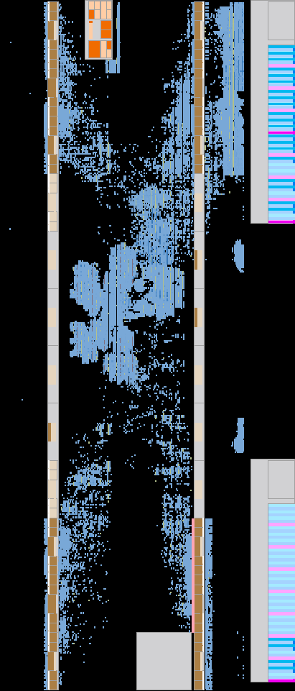
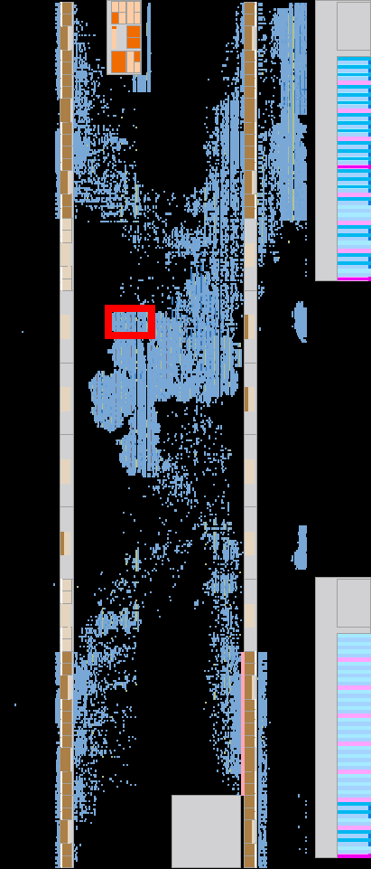
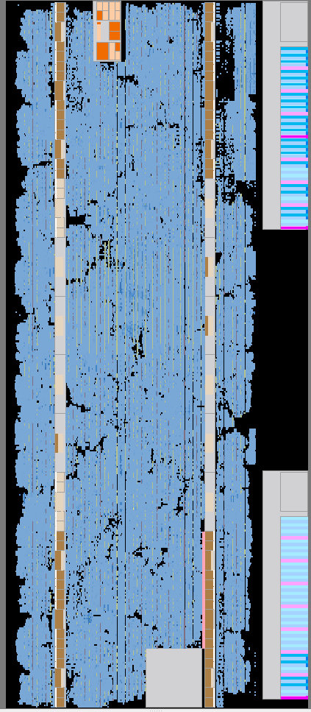
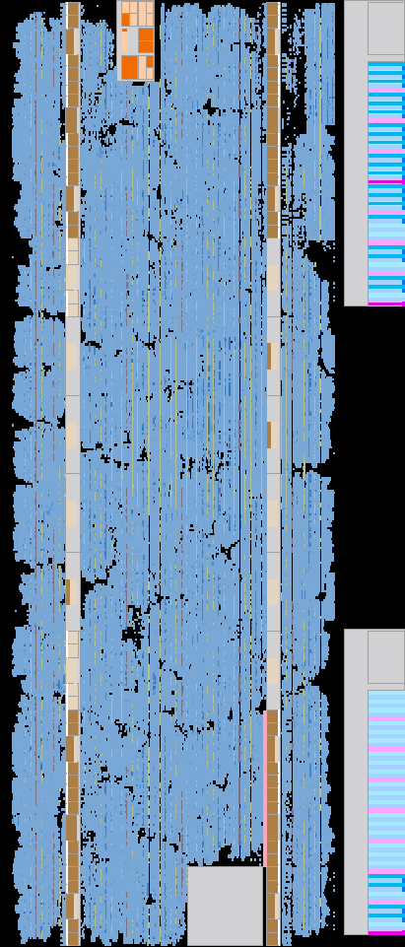
Hardware Overhead
Low area overhead of 0.045% from additional dedicated logic registers and 2.96% additional ALMs
Synthesized on Stratix 10 FPGA
1 core
16 core
Notes:
We also have minimal hardware overhead when synthesizing on the Stratix 10 FPGA.

Slide 25
Conclusion
Converts sparse operations in graph processing into dense operations using Weaver and balances workloads across GPU threads
Minimized Scheduling Overhead
Replaces shared memory search with a simple one-time scan
Reduces scheduling calculation overhead
Lightweight Hardware Logic (Weaver)
Implemented as a GPU functional unit, evaluating its potential to replace software scheduling
Notes:
Our study demonstrated that the sparse operations in graph workloads, which cause imbalances within the core, can be addressed with minimal additional hardware units.
Through hardware/software co-design based on a software solution, we introduced a central decoding structure to reduce scheduling overhead, leveraged shared memory scan to minimize memory overhead, and enabled dynamic distribution for more flexible processing.
As a result, we integrated weaver as the GPU functional units with minimal overhead and demonstrated its potential to replace software scheduling.
Discussion about future idea sharing idea , learn something …

Slide 26
Thank you!
shin0403@Yonsei.ac.kr

